Slide 1
London
England's largest city

Slide 2
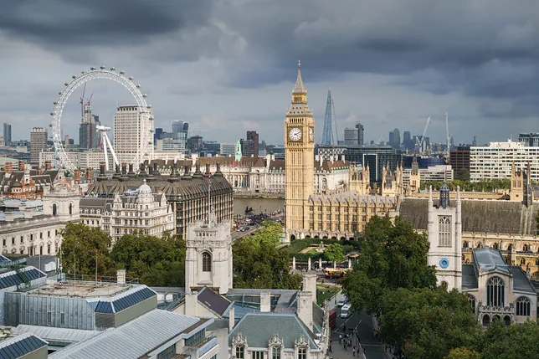
London
The capital and largest city of England and Great Britain, located in the south-eastern part of the country, on the River Thames. It is the third largest city in Europe, after Moscow and Istanbul, and at the same time one of the largest cities in the world, both in terms of the city itself and the entire agglomeration.

Slide 3
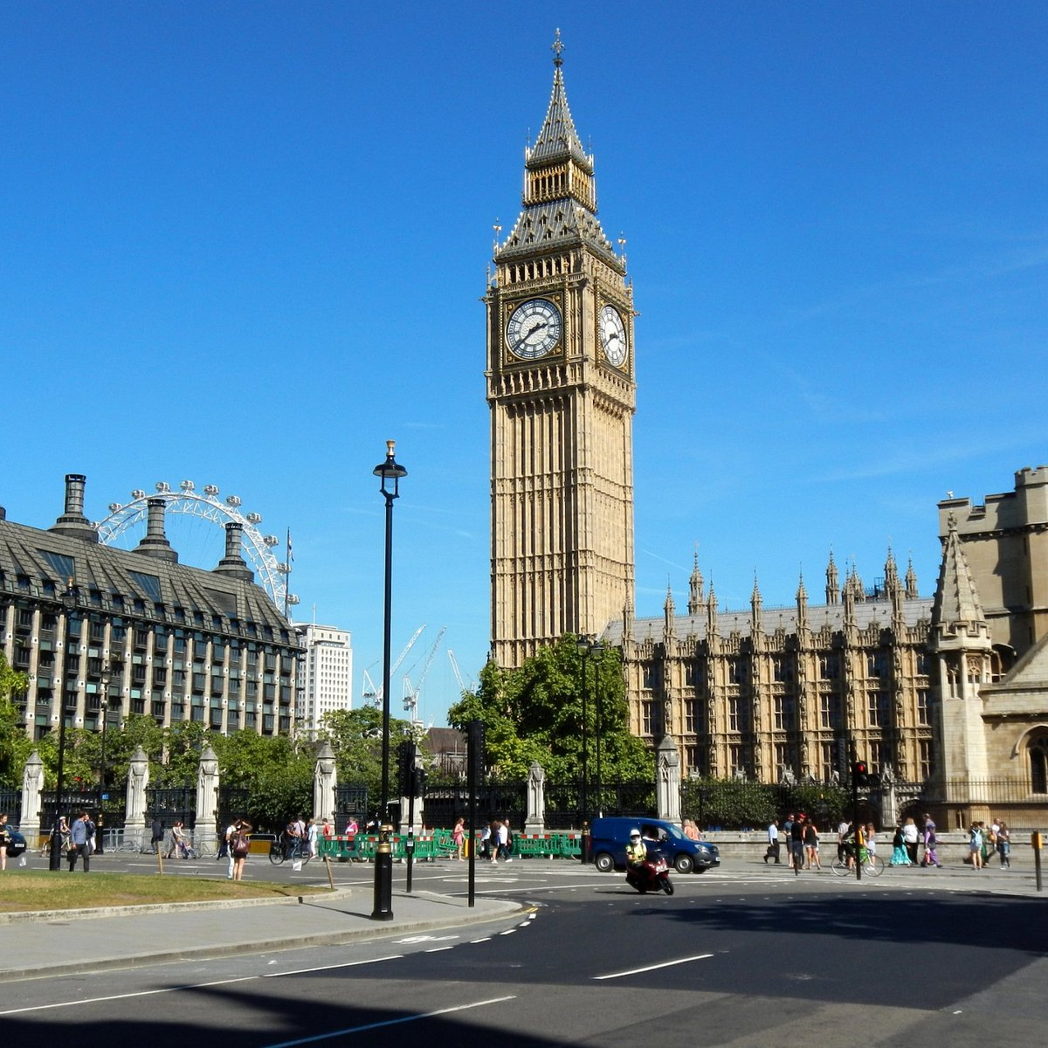
The clock tower and Big Ben
One of the undisputed symbols of London is Big Ben - the largest clock in the city, located on a neo-gothic tower. Every quarter of an hour it strikes a characteristic melody. The bell weighing 13 tons has been in use since 1859.

Slide 4
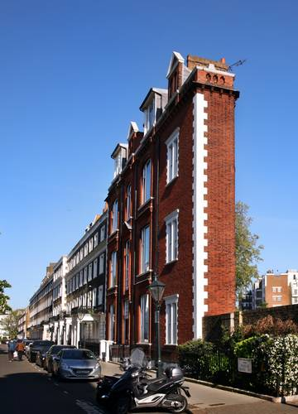
Fake townhouses
There are two fake tenement houses in London. At 23 and 24 Leinster Gardens, you can see seemingly ordinary buildings at first glance. When you come closer, you can see that they are just facades of houses built to hide the subway tracks in an open tunnel with animi. The façades were erected when the subway was laid out. They look exactly like the real tenement houses standing next to them.

Slide 5
Tower of London - prison for wrongdoing
Until 1625, the monarchs also used the Tower of London, a defensive residence erected in the 11th century by William the Conqueror. It went down in history mainly because of the dark stories that took place in it. The stronghold turned out to be a prison for Anne Boleyn, the second wife of King Henry VIII, as well as politicians Thomas Mora and Thomas Cromwell.

Slide 6
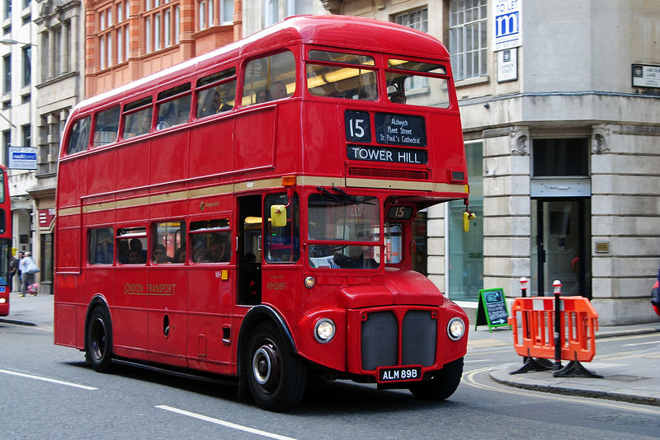
Red buses
One theory is that the first prototypes were painted red to conspicuously show drivers that they were experimental vehicles and should keep their distance. The second theory, more likely, concerned the uniformity of the color of urban vehicles. It happened in 1933, when several passenger transport companies merged into one body. The color is Pantone 485 C - the same shade of red is used by the British Royal Mail, the Kit Kat brand, the McDonald's fast food chain and the Russians for the production of state flags. Interestingly, most of the roofs of the buses are painted white to reflect the light on warm, sunny days, keeping the inside temperature slightly cooler.

Slide 7
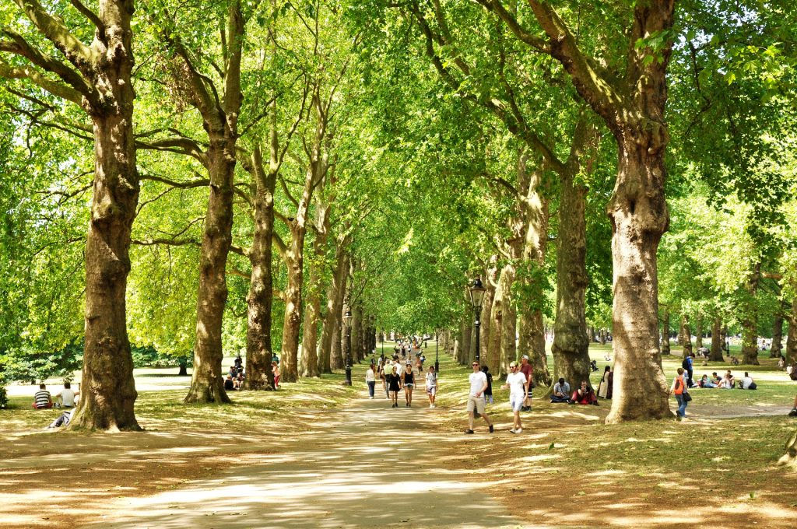
London is actually a forest
London is an exceptionally green city. In addition to nearly 9 million people, there are also 8.3 million trees and millions of other plants on 600 square miles. The density of trees is so high that the UN defines London as a forest. The definition says that a forest is an area with 20% of its area covered by trees. In London it is 21%.

Slide 8
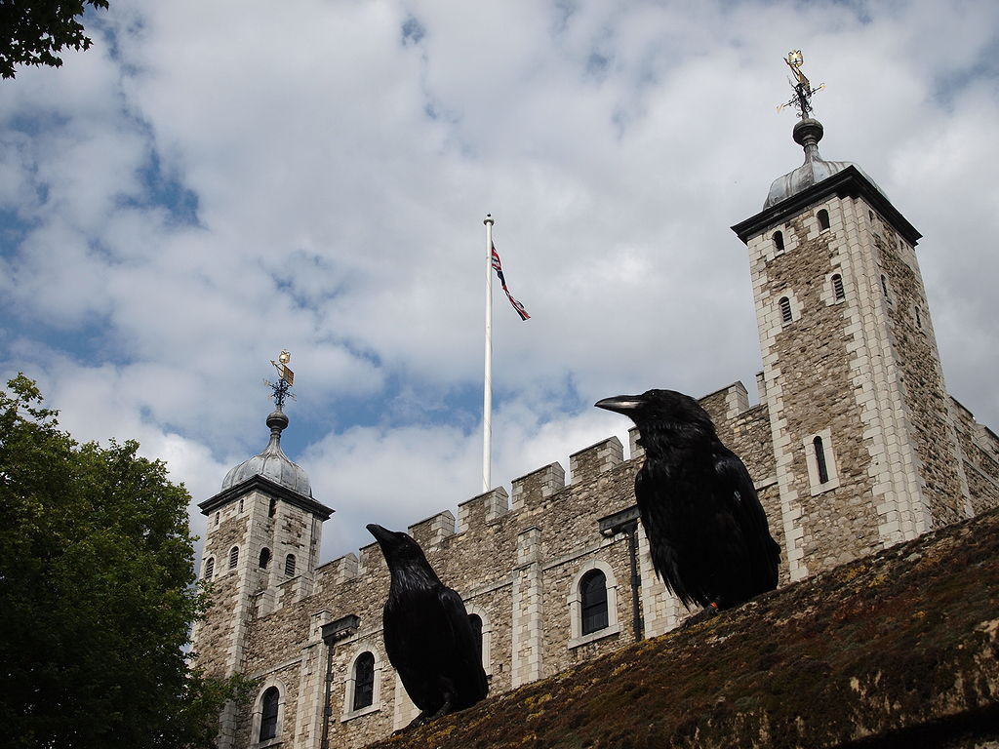
The requirement of the ravens in the Tower of London
By decree of King Charles II, a minimum of six ravens must be present in the Tower of London at all times. According to the legend, "if the ravens of the Tower of London are lost or fly away, the Crown will fall and Britain with it." Eight ravens are kept in the tower for safety. The Crown Jewels of the Queen of England are also housed in the Tower. Among the 25,578 jewels is the 530 carat Cullinan diamond atop the Royal Scepter. Largest part (until 1985) of the largest diamond ever found.

Slide 9
Thank you for your attention
Emilka Szpilarska

